Slide 1
translationRecorder v1.2.4
Recording from project manager
Audio Recordings

Slide 2
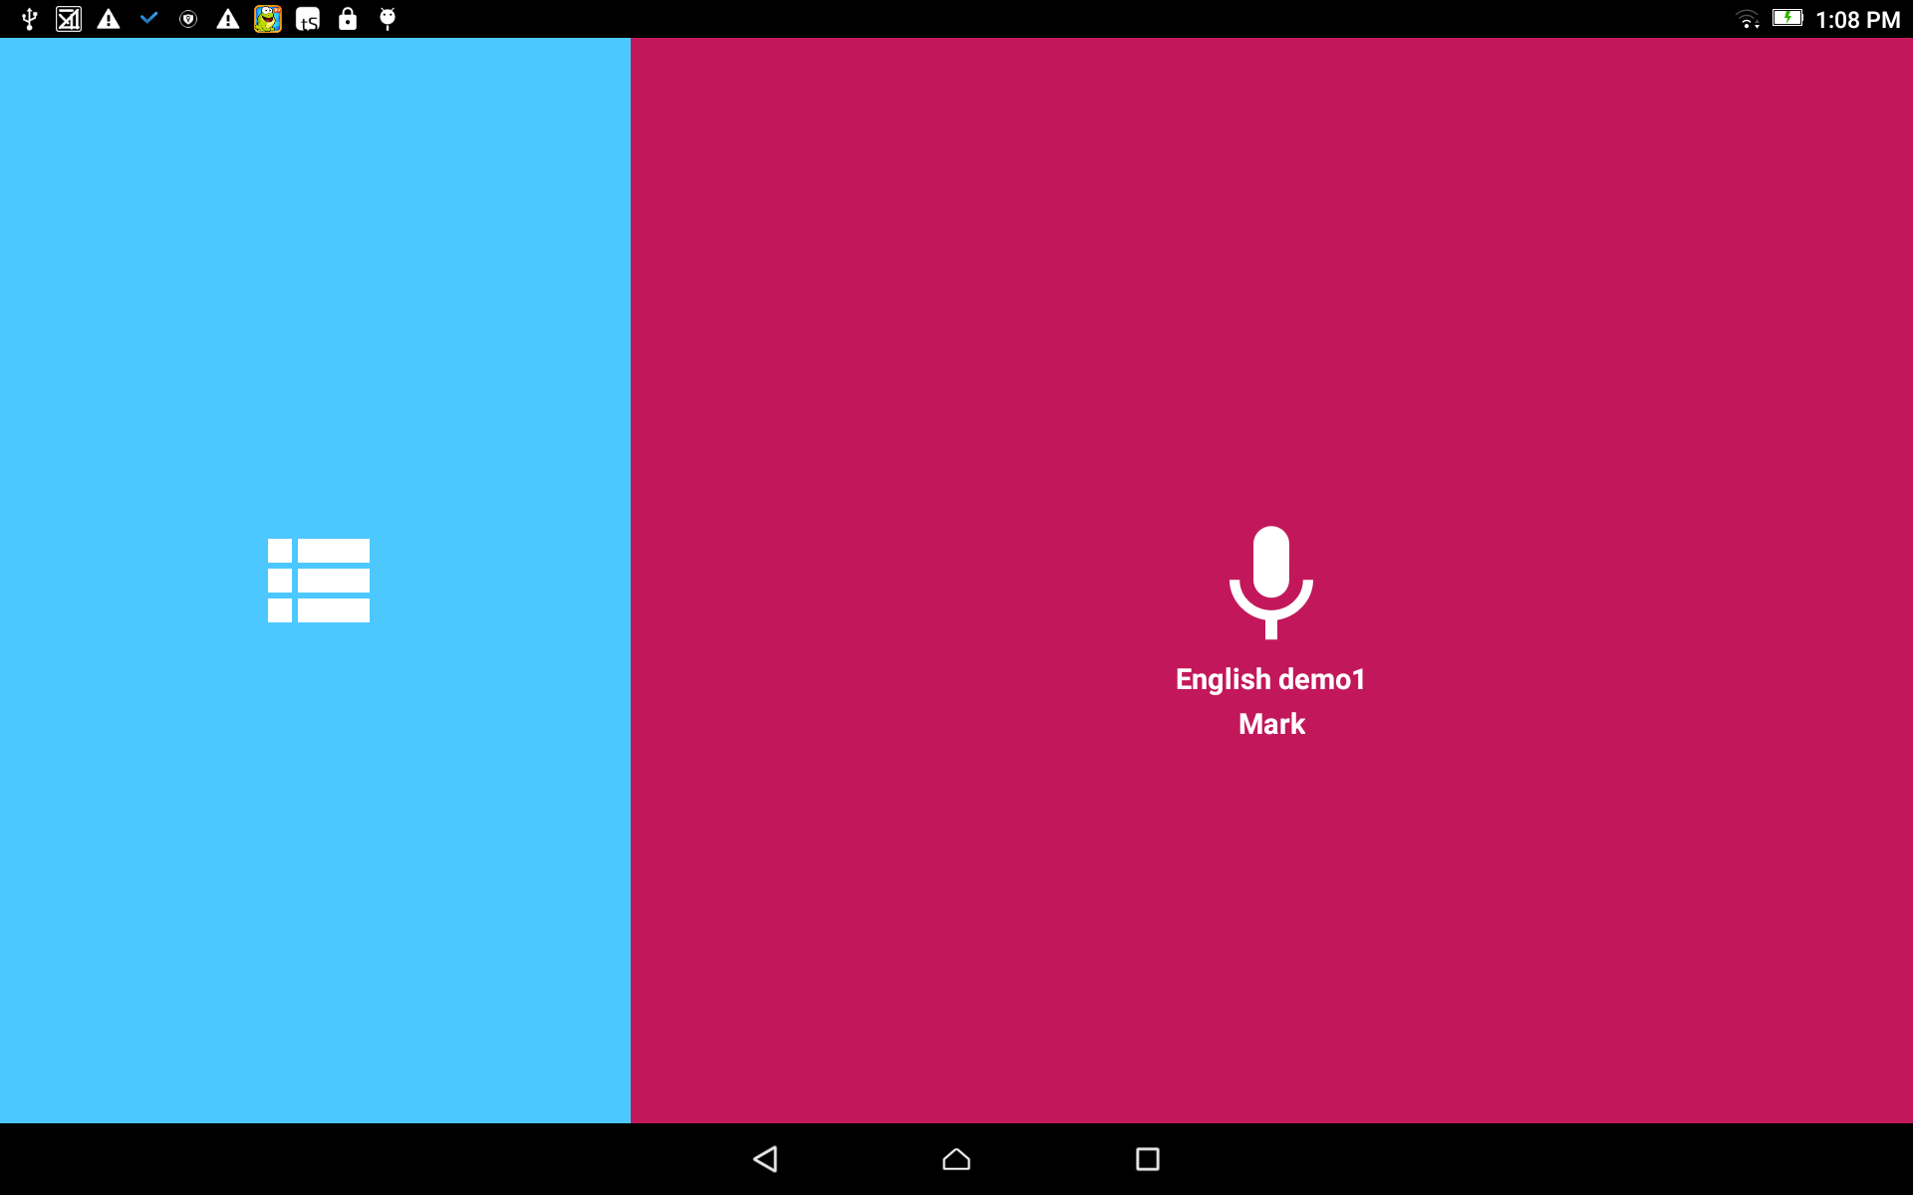
Recording (from Project Manager):
From the home screen, tap in the blue area to open the Project Manager.
This step is for when the user returns to a recording session

Slide 3
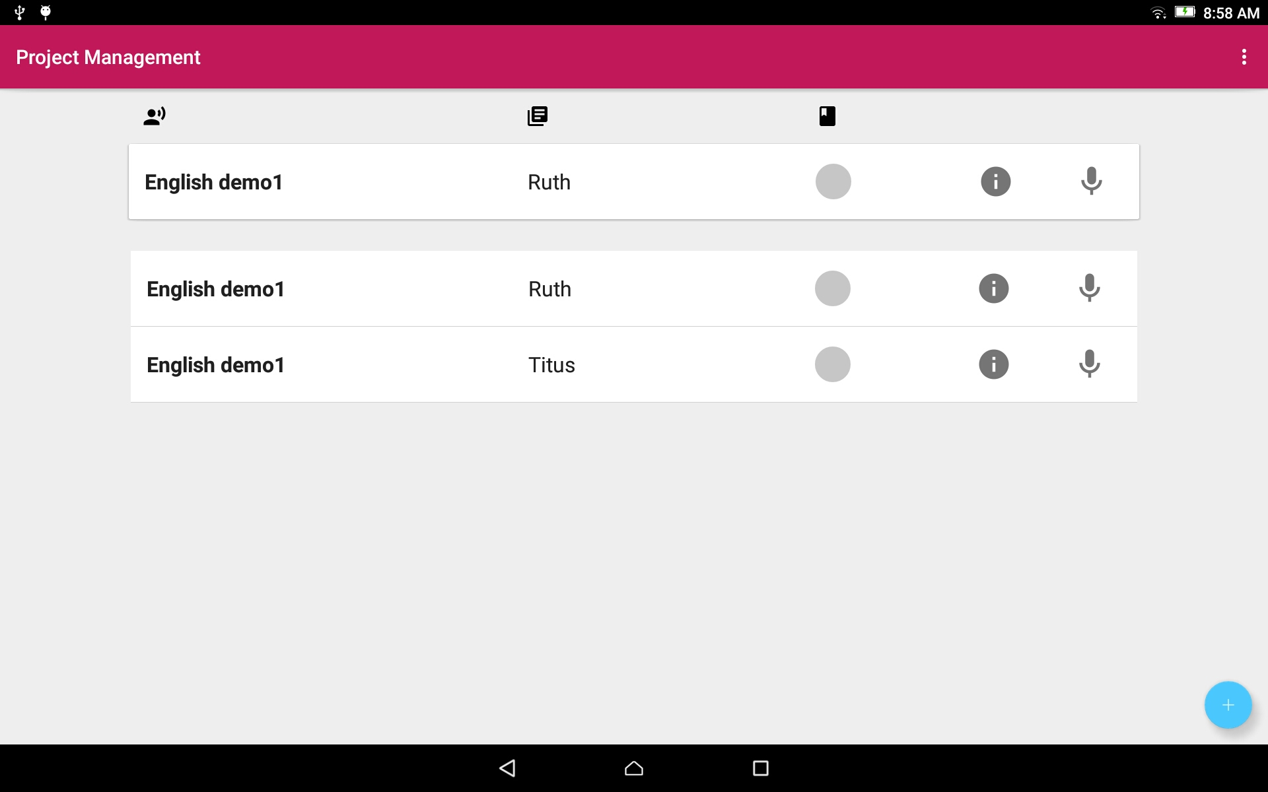
Project Manager:
Tap on the project bar to open the project.
At the top of the list is the project that was worked on last.
These projects are the same project. They are listed 2 times.

Slide 4
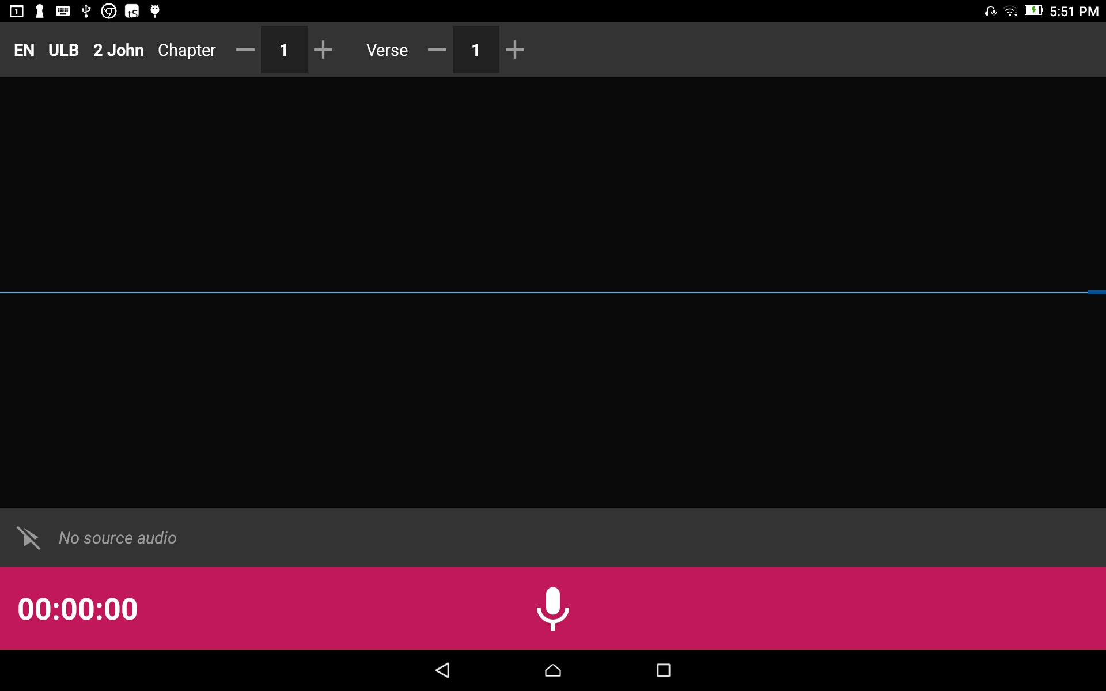
The Project Opens:
Have the written text open to the first verse that will be read.

Slide 5

Recording:
Check the information on the top gray bar:
Target Language
Project Type
Book
Chapter
Verse or Chunk

Slide 6
Recording:
Check the information on the top gray bar:
Choose the plus and minus signs to change the numbers.

Slide 7
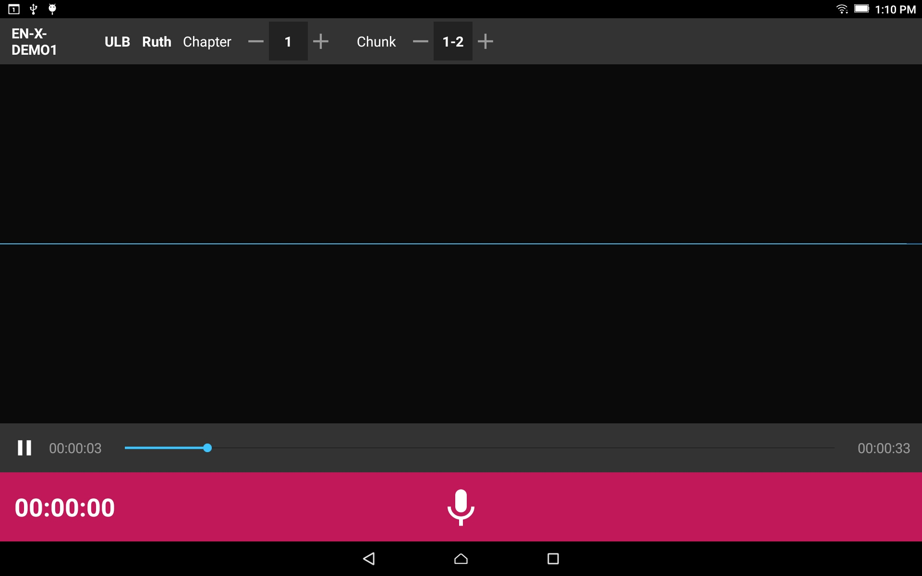
Recording:
Tap on the microphone icon on the pink bar.

Slide 8
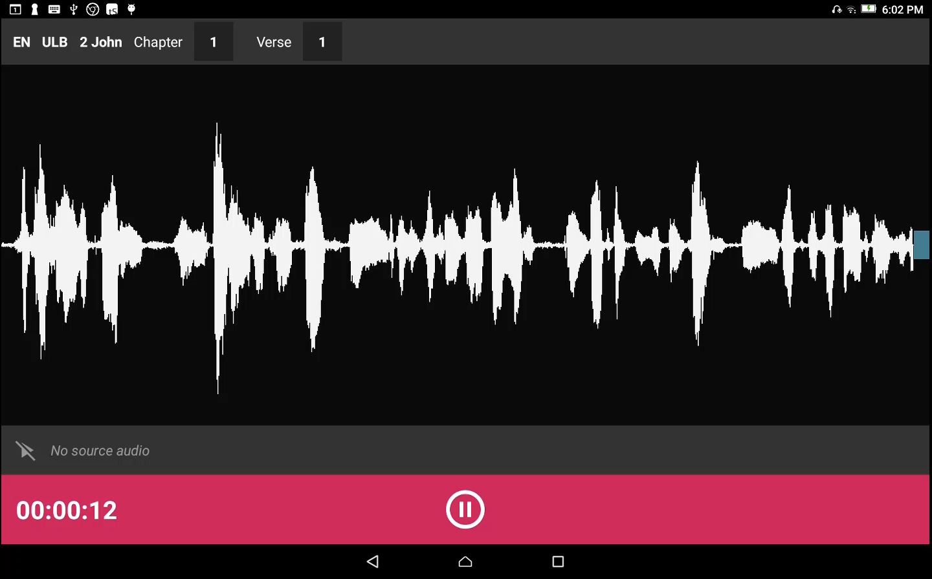
Recording:
Read the text out loud. As you begin to speak you will see waves appear on the screen which is a result of the sound of your voice.

Slide 9
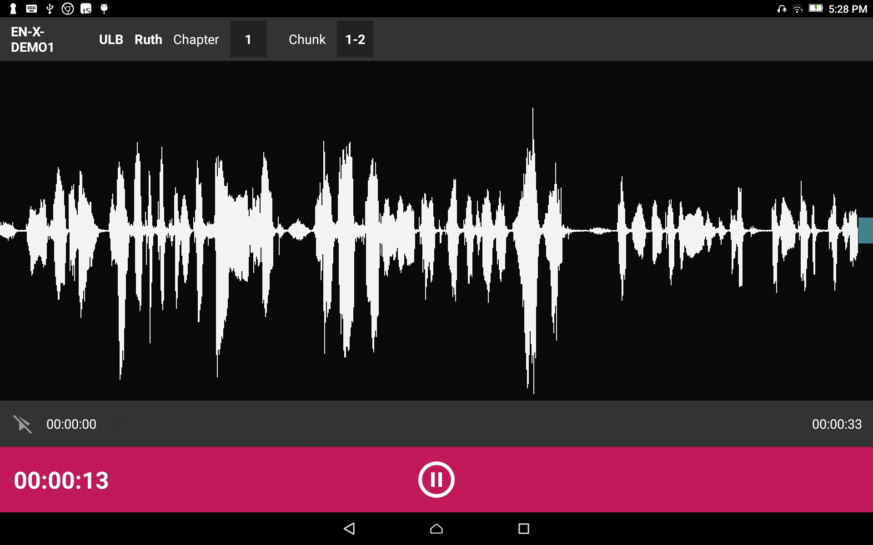
Recording:
When done with that portion, tap the pause button.

Slide 10
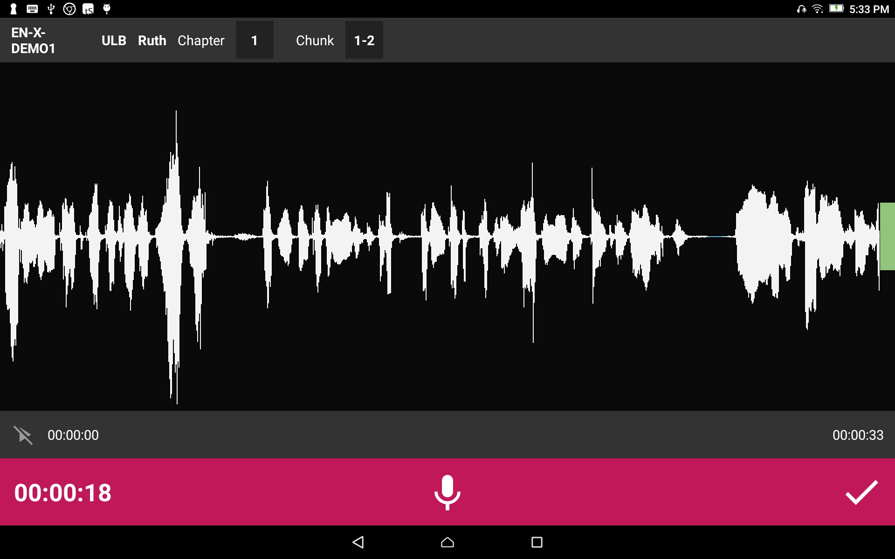
Recording:
Tap the checkmark to save the recording.

